Slide 1
Chapter 5. Fourier Transform

Slide 2

Metropolis algorithm for Monte Carlo
Simplex method for linear programming
Krylov subspace iteration (CG)
Decomposition approach to matrix computation (LU, Singular value)
The Fortran compiler
QR algorithm for eigenvalues
Quick sort
Fast Fourier transform
Integer relation detection
Fast multipole

Slide 3
Fourier Transform
Fourier analysis and orthogonal functions
Discrete Fourier transform
Fast Fourier transform

Slide 4
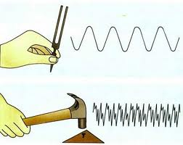
Periodic motion
1/T, 2/T, 3/T, 4/T, ......
Fourier first pointed out that an arbitrary periodic function f(t), with a period T, can be decomposed into a summation of simple harmonic terms, which are periodic functions of frequencies that are multiples of the fundamental frequency 1/T of the function f(t).

Slide 5
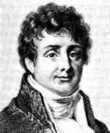
Jean Baptiste Joseph Fourier
He was a French mathematician and physicist born in Auxerre and best known for initiating the investigation of Fourier series and their applications to problems of heat transfer and vibrations.
The Fourier transform and Fourier's Law are also named in his honor.
Fourier is also generally credited with the discovery of the greenhouse effect.
(21 March 1768 –
16 May 1830)

Slide 6
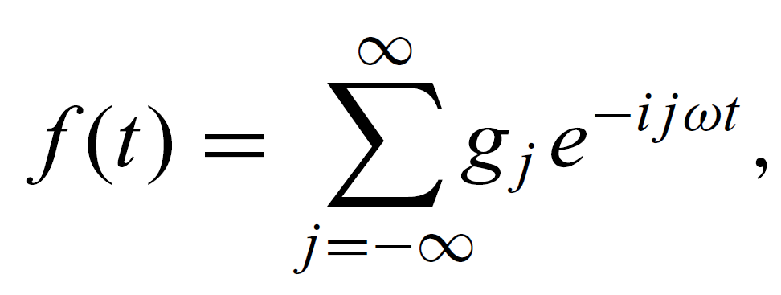
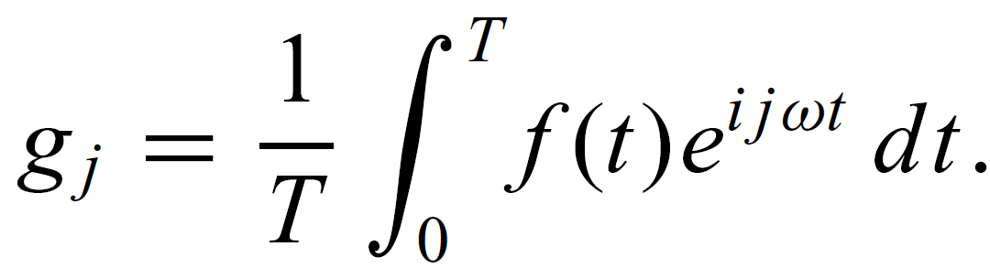
Assuming that we have a time-dependent function f(t) with a period T, that is, f(t+T) = f(t), the Fourier theorem can be cast as a summation
which is commonly known as the Fourier series. Here ω= 2π/T is the fundamental angular frequency and g_{j}'s are the Fourier coefficients, which are given by

Slide 7
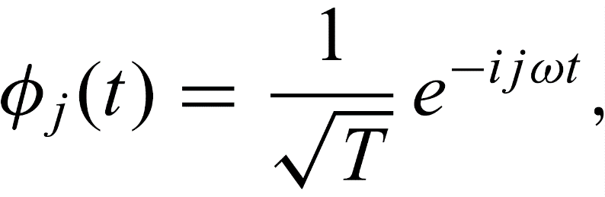
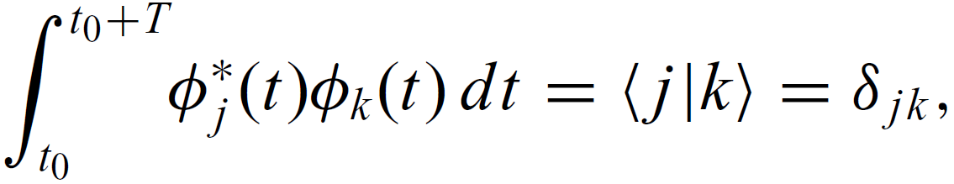
The Fourier theorem can be derived from the properties of the exponential functions
which form an orthonormal basis set in the region of one period of f(t):
where t₀ is an arbitrary starting point, φ*_{j} (t) is the complex conjugate of φ_{j} (t), and δ_{jk} is the Kronecker function. We can always take t₀ = 0 for convenience, because it is arbitrary.

Slide 8
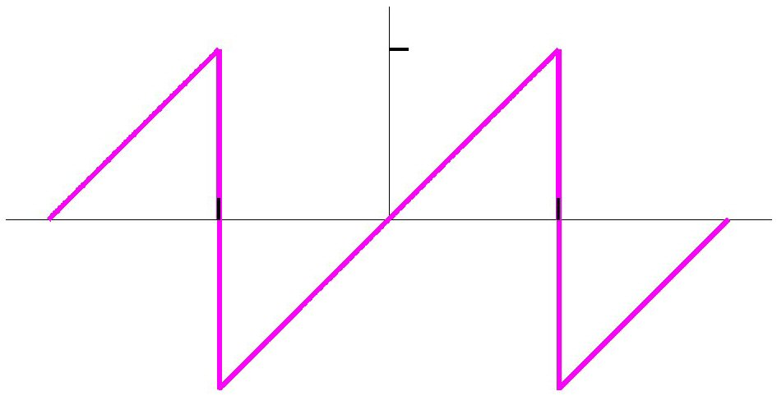
Fourier series example: sawtooth wave
1
…
…
-1
1

Slide 9
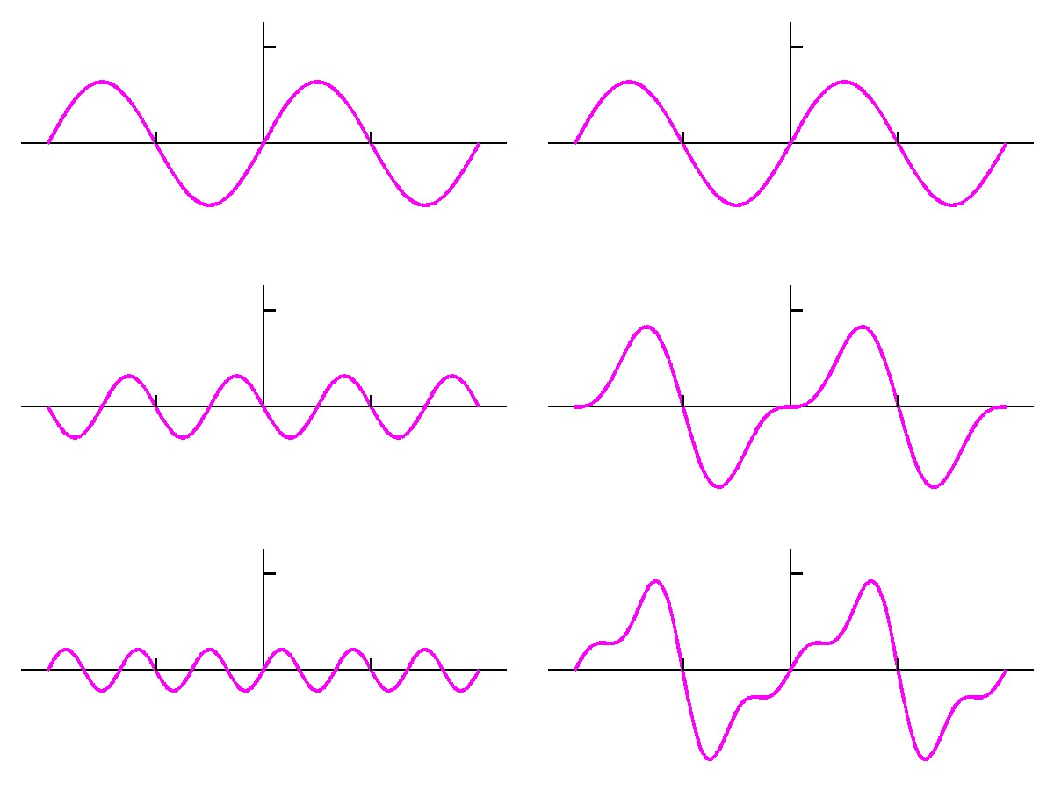
Sawtooth wave summation
1
2
3
n
Harmonics
Harmonic sums

Slide 10
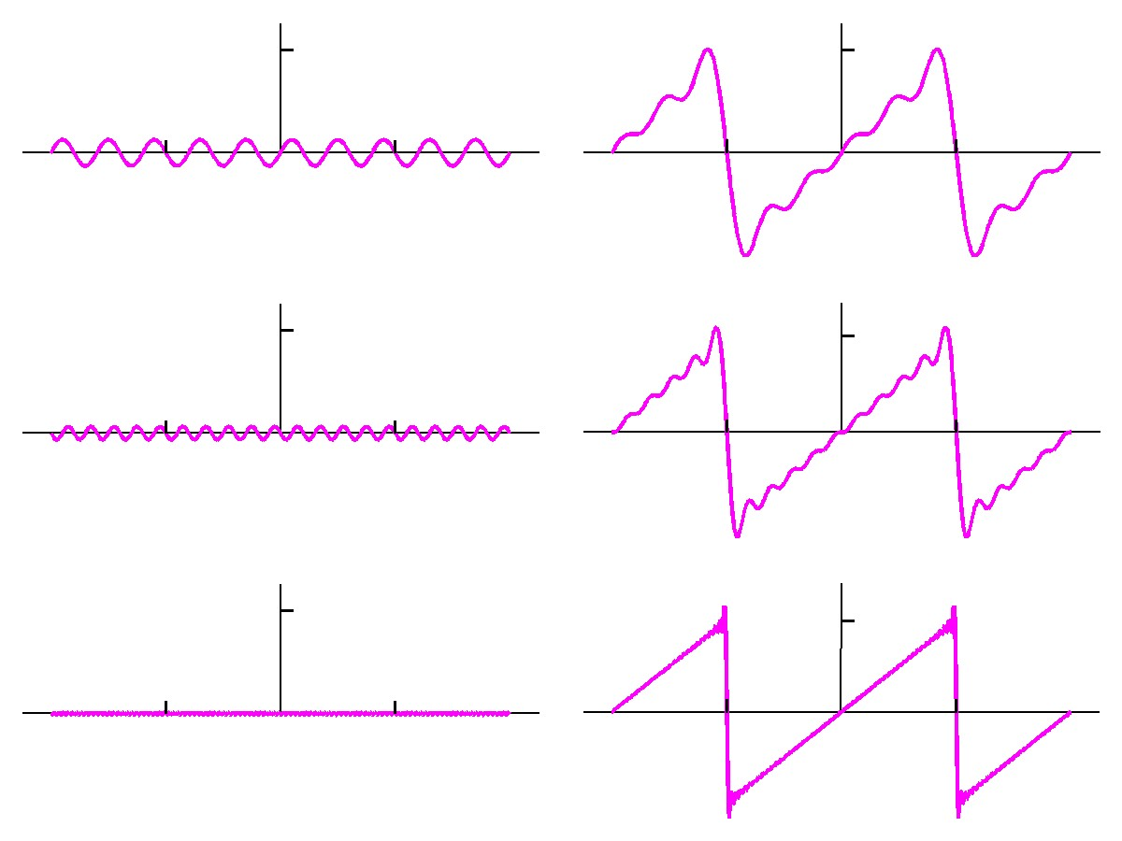
Sawtooth wave summation (continued)
5
10
50
n
Harmonics
Harmonic sums

Slide 11
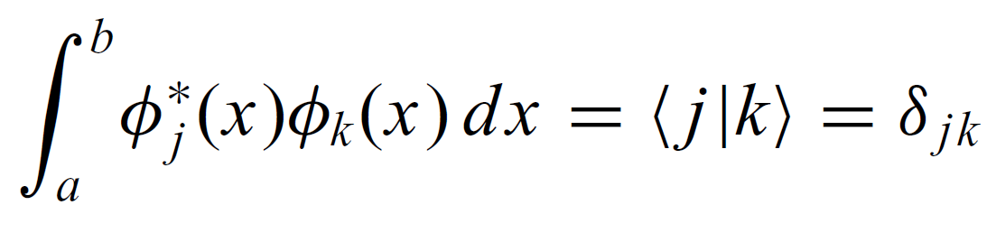
Fourier analysis and orthogonal functions
We can generalize the Fourier theorem to a nonperiodic function defined in a region of x∈[a, b] if we have a complete basis set of orthonormal functions φ_{k}(x) with

Slide 12
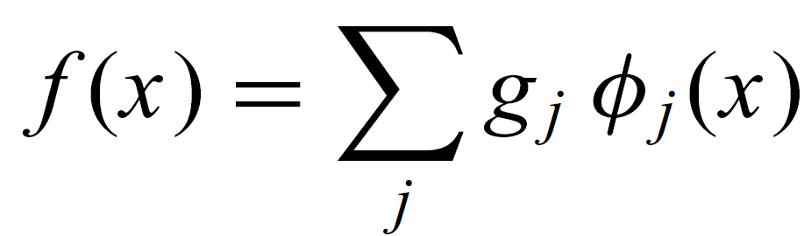
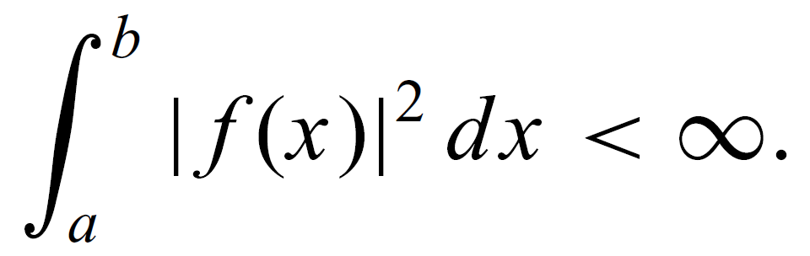
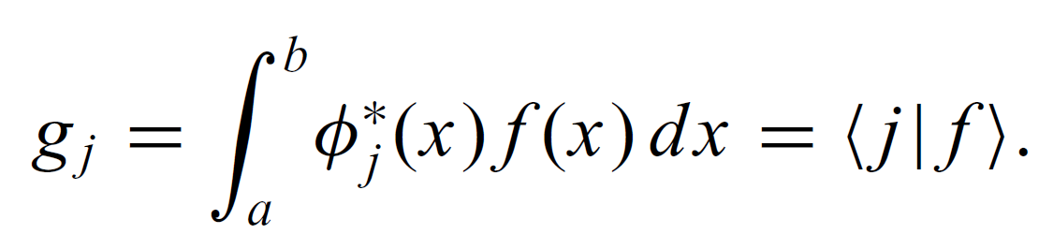
For any arbitrary function f(x) defined in the region of x∈[a, b], it can be written as:
if the function is square integrable, defined by
the coefficients g_{j} are given by

Slide 13
The continuous Fourier transform is obtained if we restrict the series to the region of t ∈ [-T/2, T/2] and then extend the period T to infinity. Then the sum becomes an integral:
which is commonly known as the Fourier integral. The Fourier coefficient function is given by
The Fourier transform & the inverse Fourier transform

Slide 14
Another convention for Fourier transform

Slide 15
Fourier Transforms are used in
X-ray diffraction
Electron microscopy (and diffraction)
NMR spectroscopy
IR spectroscopy
Fluorescence spectroscopy
Image processing
Plane wave DFT calculations
etc.

Slide 16
Application of Fourier transform: find out periodic signal in a noisy background
0.333 Hz

Slide 17
Fourier Transform Magnitude and Phase
As with any complex quantity, we can decompose f(t) and F(ω) into their magnitude and phase.
f(t) can be written: f(t) = Mag{f(t)} exp[ -i Phase{f(t)}]
where Mag{f(t)}² is often called the intensity, I(t), and Phase{f(t)} is called the phase, φ(t).
Analogously, F(ω) = Mag{F(ω)} exp[ -i Phase{F(ω)}]
The Mag{F(ω)}² is called the spectrum, S(ω), and the Phase{F(ω)} is called the spectral phase, ϕ(ω).
Just as both the intensity and phase are required to specify f(t), both the spectrum and spectral phase are required to specify F(ω), and hence f(t).

Slide 18


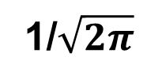
Fourier Transform of δ(t) is 1/$\sqrt{2π}$.
δ(t)
1/$\sqrt{2π}$
t
ω
And the Fourier Transform of 1:
1
$\sqrt{2π}$δ(ω)
t
ω

Slide 19
Time Reversal
is neglected for simplicity
Pf)

Slide 20
Fourier Transform for Real Functions
If f(t) is a real function, and F(ω) = F_{R}(ω) + iF_{I}(ω)
F(−ω) = F*(ω)

Slide 21
Fourier Transform for Real Functions
If f(t) is a real function, and F(ω) = F_{R}(ω) + iF_{I}(ω)
F(−ω) = F*(ω)
F_{R}(−ω) = F_{R}(ω)
F_{I}(−ω) = −F_{I}(ω)
F_{R}(ω) is even, and F_{I}(ω) is odd.
Magnitude spectrum |F(ω)| is even, and phase spectrum φ(ω) is odd.

Slide 22
Fourier Transform for Real Functions
If f(t) is real and even
If f(t) is real and odd
F(ω) is real
F(ω) is pure imaginary
√
√
Pf)
Pf)
Even
Odd
Real
Real

Slide 23
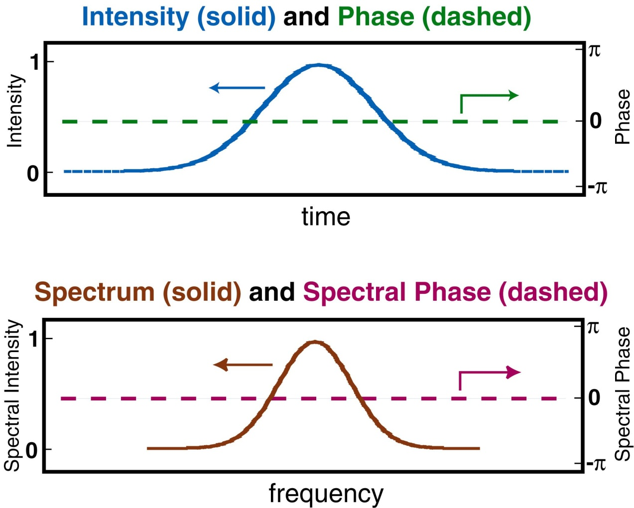
Intensity and Phase of a Gaussian
The Gaussian is real, so its phase is zero.
Time domain:
Frequency domain:
A Gaussian transforms
to a Gaussian
So the spectral phase is zero, too.

Slide 24
Scale Theorem
The Fourier transform of a scaled function, f(at):
Proof:
Assuming a > 0, change variables: u = at
If a < 0, the limits flip when we change variables, introducing a minus sign, hence the absolute value.

Slide 25
f(t)
F(ω)
The Scale Theorem in action
Short pulse
t
ω
The shorter the pulse, the broader the spectrum!
Medium- length pulse
t
ω
This is the essence of the Uncertainty Principle!
Long pulse
t
ω

Slide 26
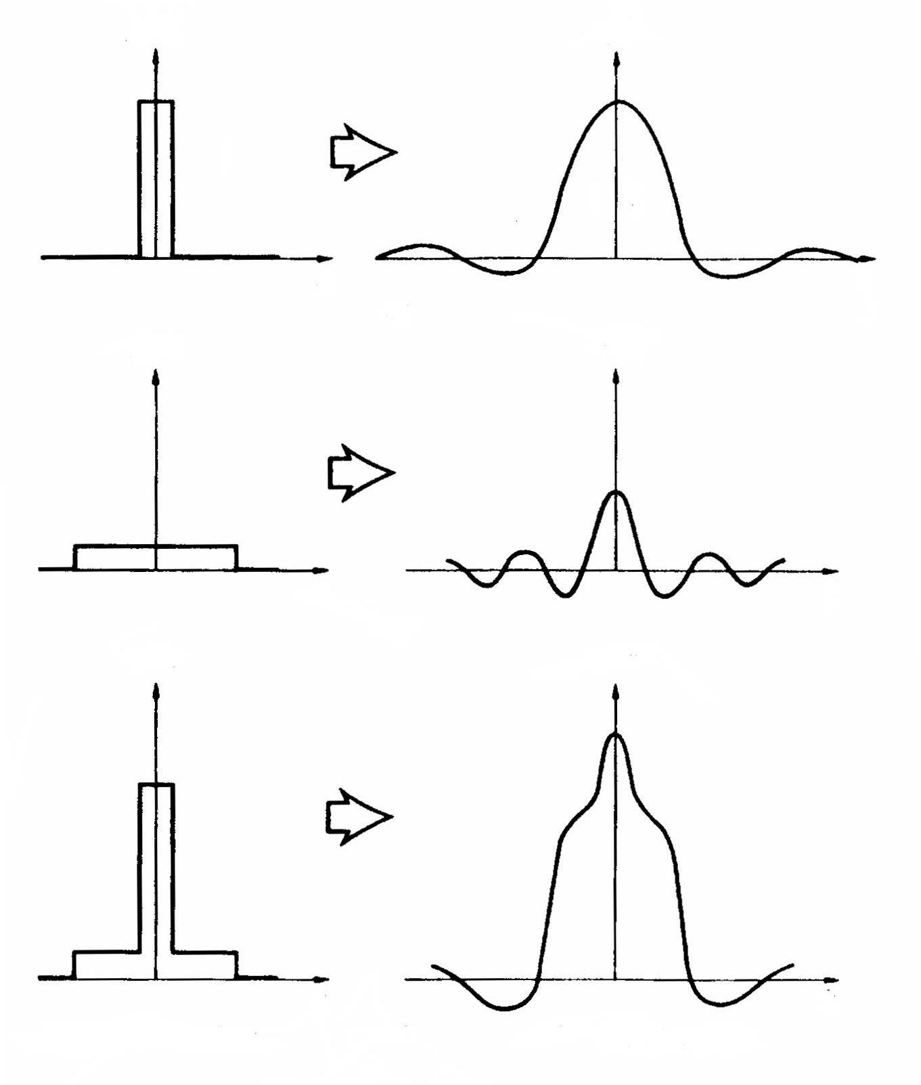
The Fourier Transform of a sum of two functions
f(t)
F(ω)
t
ω
g(t)
G(ω)
t
ω
F(ω) + G(ω)
f(t)+g(t)
Also, constants factor out.
t
ω

Slide 27
Shift Theorem

Slide 28
Fourier Transform of the complex conjugate of a function
Proof:

Slide 29
Derivative Theorem
The Fourier transform of a derivative of a function, f’(t):
Proof:

Slide 30
Modulation Theorem Fourier Transform of E(t) cos(ω₀ t)

Slide 31
Fourier Transform of a convolution
The convolution of two functions f₁(t) and f₂(t) is defined as:

Slide 32
Properties of Convolution

Slide 33
Time Domain
Frequency Domain
convolution
multiplication

Slide 34
Parseval’s Theorem
Energy in temporal space is the same as the energy in spectral space!

Slide 35
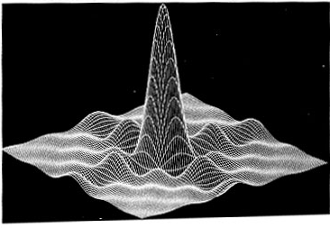
The 2D Fourier Transform
F ⁽²⁾{f(x,y)} = F(k_{x},k_{y})
= f(x,y) exp[-i(k_{x}x+k_{y}y)] dx dy
If f(x,y) = f_{x}(x) f_{y}(y),
then the 2D FT splits into two 1D FT's.
But this doesn’t always happen.
f(x,y)
y
x
F ⁽²⁾{f(x,y)}

Slide 36
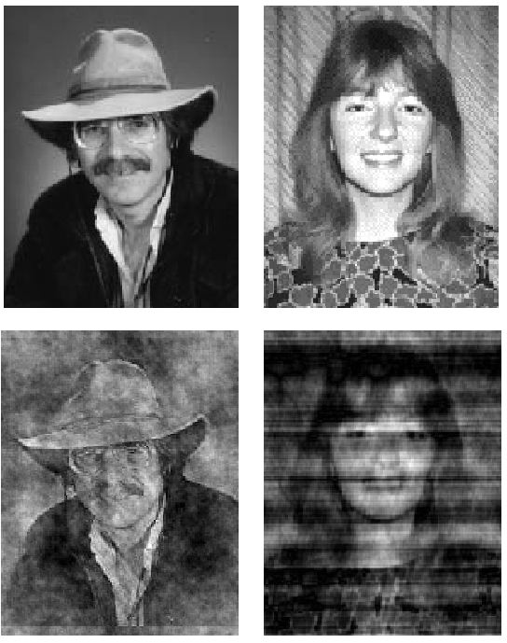
Fourier Transform Magnitude and Phase
Rick
Linda
Pictures reconstructed
using the spectral phase
of the other picture
Mag{F [Linda]}
Phase{F [Rick]}
Mag{F [Rick]}
Phase{F {Linda]}
The phase of the Fourier transform (spectral phase) is much more important than the magnitude in reconstructing an image.

Slide 37
Three dimensions
The space defined by q is usually called the momentum space.

Slide 38
Discrete Fourier transform
f(x): a physical quantity obtained from measurements. The measurements are between x=0 and x=L.
The data are measured at evenly spaced points with each interval h=L/N, where N is the total number of data points.
Assume that the data repeat periodically outside the region of x∈[0,L], which is equivalent to the periodic boundary condition on the finite system.
The corresponding wavenumber in the momentum space is then discrete too, with an interval κ=2π/L.

Slide 39
Derivation of Discrete Fourier transform
…
0
1
2
3
N-1
N
Assume that the data repeat periodically outside the region of x∈[0,L], which is equivalent to the periodic boundary condition on the finite system.

Slide 40
(1) Assume periodicity
(2) Numerical integration
Use trapezoidal Rule

Slide 41
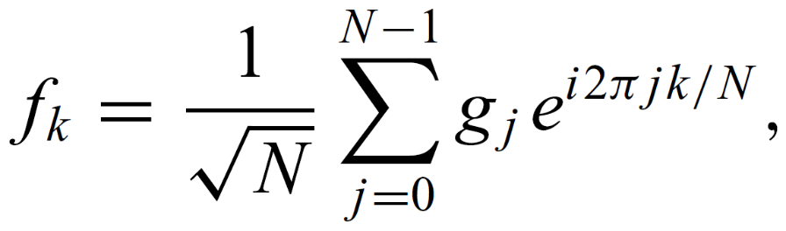
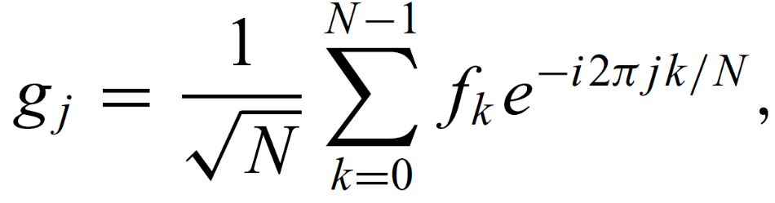
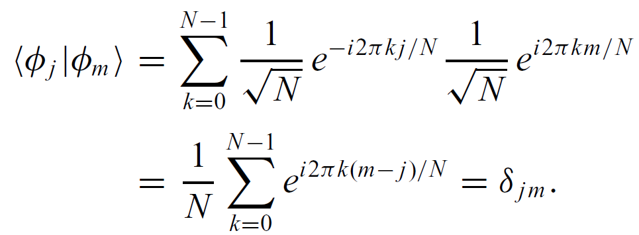
Discrete Fourier transform (DFT)
Periodicity:
The exponential functions in the series form a discrete basis set of orthogonal functions:

Slide 42

DFT vs. Fourier transform
Time range: between 0 and L
t=kL/N

Slide 43
Code example
f₁(x)=sin(2πx)+sin(50πx+1)+sin(104πx+2)
f₂(x)=-sin(2πx)+sin(50πx+2)+sin(104πx+1)
x within [0,1].

Slide 44
Fourier.cpp
0 -1.27637e-14 0 1.27637e-14
1 -1.8072e-14 -90.5097 90.5097
2 -1.26645e-14 -4.54899e-15 1.34568e-14
…
24 -8.24868e-14 4.43416e-14 9.36496e-14
25 76.1613 -48.9026 90.5097
26 6.77505e-14 -4.97099e-14 8.4031e-14
…
51 -1.74382e-13 -7.42175e-14 1.89519e-13
52 82.3002 37.6653 90.5097

Slide 45
Aliasing
There are many sine-waves, SAMPLED with the same measurements. Which is the correct one?
Intensity [a.u.]
2
3
4
5
6

Slide 46
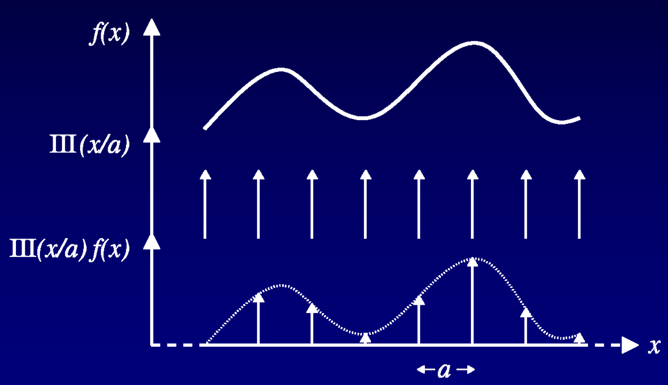
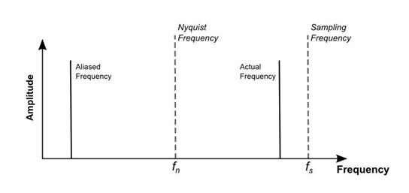
Nyquist frequency
a = L / N
For a given sampling interval, the maximum recordable frequency of 1/(2a) is known as the Nyquist frequency
Nyquist frequency = (1 / 2) * N / L when N / L is the sampling frequency.
If f(x) contains frequencies greater than the Nyquist frequency 1/(2a), then it is said to be undersampled

Slide 47
Fast Fourier transform
The straightforward discrete Fourier transform algorithm is very inefficient, because the computing time needed is proportional to N².
Speed: FFT (fast Fourier transform).
Basic idea: N number DFT-> two N/2 DFT
by Cooley and Tukey (1965)
Discrete FT
FFT

Slide 48

4-Point DFT case
Here the factor 1/sqrt(N) have been ignored.
when N=4:
Decimate in time into 2 series:
n = {0 , 2} and {1, 3}
$${(W}_{4}^{2k}=W_{2}^{k})$$

Slide 49
4-Point FFT Flow Diagram
The 2 DFT’s:
for k=0,1,2,3
For k=0 only:
A ‘flow-diagram’ of it:
x₍₀₎
+
+
W₄⁰
x₍₂₎
W₄⁰
x₍₁₎
This is for only 1/4 of the
whole diagram !
+
W₄⁰
x₍₃₎

Slide 50
A Complete Diagram
x(0)
X₄(0)
0
Note:
0
x(2)
2
X₄(1)
1
x(1)
2
X₄(2)
0
x(3)
2
3
X₄(3)

Slide 51
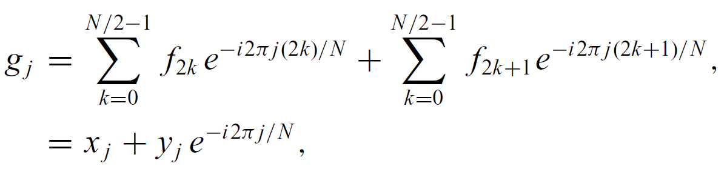
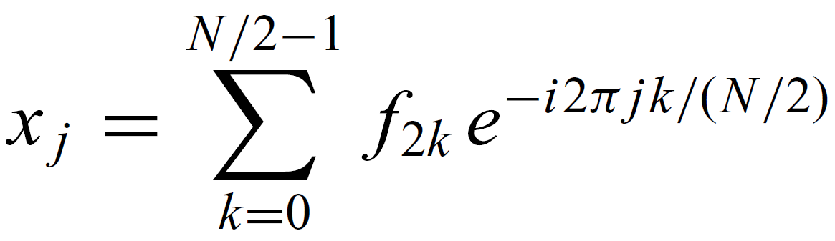
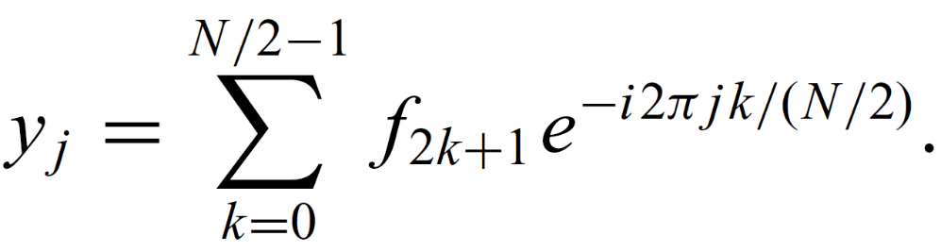
Fast Fourier transform: general discussion
The simplest fast Fourier transform algorithm is accomplished with the observation that we can separate the odd and even terms in the discrete Fourier transform as

Slide 52
This process can be repeated further and further until eventually we have only two terms in each summation if N = 2^{M}, where M is an integer.
There is one more symmetry between g_{j} for j < N/2 and g_{j} for j ≥ N/2:
where w = e^{-i2π/N} and j = 0, 1, . . . , N/2-1.
Proof:

Slide 53
After the summation is decomposed M times, we need to add individual data points in pairs.
However, due to the sorting of the odd and even terms in every level of decomposition, the points in each pair at the first level of additions can be very far apart in the original data string.
For example, if N=8, the decomposition is like:
0-7
0 2 4 6 1 3 5 7
0:4 2:6 1:5 3:7

Slide 54
Cooley and Tukey (1965) found that if we record the data string index with a binary number, a bit-reversed order will put each pair of data points next to each other for the summations at the first level.
0
1
2
3
4
5
6
7
000
001
010
011
100
101
110
111
000
100
010
110
001
101
011
111
0
4
2
6
1
5
3
7
bit-reversed order
0-7
0 2 4 6 1 3 5 7
0:4 2:6 1:5 3:7

Slide 55
g_{j} (0, 1, 2, 3, 4, 5, 6, 7)=x_{j} (0, 2, 4, 6)+w_{j} y_{j} (1, 3, 5, 7)
1
w_{j}=exp(-i2πj/8) (j=0-3)
g₀=x₀+w₀y₀ g₁=x₁+w₁y₁ g₂=x₂+w₂y₂ g₃=x₃+w₃y₃
g₄=x₀-w₀y₀ g₅=x₁-w₁y₁ g₆=x₂-w₂y₂ g₇=x₃-w₃y₃
2
x_{j} (0, 2, 4, 6) = xx_{j} (0, 4) + ww_{j} xy_{j} (2, 6)
y_{j} (1, 3, 5, 7) = yx_{j} (1, 5) + ww_{j} yy_{j} (3, 7)
ww_{j}=exp(-i2πj/4) (j=0-1)
x₀=xx₀+ww₀xy₀ x₁=xx₁+ww₁xy₁ y₀=yx₀+ww₀yy₀ y₁=yx₁+ww₁yy₁
x₂=xx₀-ww₀xy₀ x₃=xx₁-ww₁xy₁ y₂=yx₀-ww₀yy₀ y₃=yx₁-ww₁yy₁
3
xx_{j}(0,4)=xxx_{j}(0)+www_{j} xxy_{j}(4) xy_{j}(2,6)=xyx_{j}(2)+www_{j} xyy_{j}(6)
yx_{j}(1,5)=yxx_{j}(1)+www_{j} yxy_{j}(5) yy_{j}(3,7)=yyx_{j}(3)+www_{j} yyy_{j}(7)
www_{j}=exp(-i2πj/2) (j=0) www₀=1
xx₀=f₀+f₄ xy₀=f₂+f₆ yx₀=f₁+f₅ yy₀=f₃+f₇
xx₁=f₀-f₄ xy₁=f₂-f₆ yx₁=f₁-f₅ yy₁=f₃-f₇

Slide 56
From bottom to top
f₀ f₄ f₂ f₆ f₁ f₅ f₃ f₇
xx₀
xx₁
xy₀
xy₁
yx₀
yx₁
yy₀
yy₁
x₀
x₁
x₂
x₃
y₀
y₁
y₂
y₃
g₀
g₁
g₂
g₃
g₄
g₅
g₆
g₇

Slide 57

翻花绳

Slide 58
Code example
f₁(x)=sin(2πx)+sin(50πx+1)+sin(104πx+2)
within [0,1].
FFT.cpp
With the FFT algorithm, the computing time is reduced.
A careful analysis shows that the total computing time is proportional to N log₂N instead of to N².

Slide 59
FFTW
The Fastest Fourier Transform in the West (FFTW) is a software library for computing discrete Fourier transforms developed by Matteo Frigo and Steven G. Johnson at the Massachusetts Institute of Technology.
Website: http://www.fftw.org
Stable version: 3.3.8
Any N is allowed
License: GPL, commercial

Slide 60
FFTW example
fftw3_test.f90
ifort fftw3_test.f90 -I/opt/intel/mkl/include/fftw -mkl=sequential
See also
https://people.sc.fsu.edu/~jburkardt/f_src/fftw3/fftw3.html

Slide 61
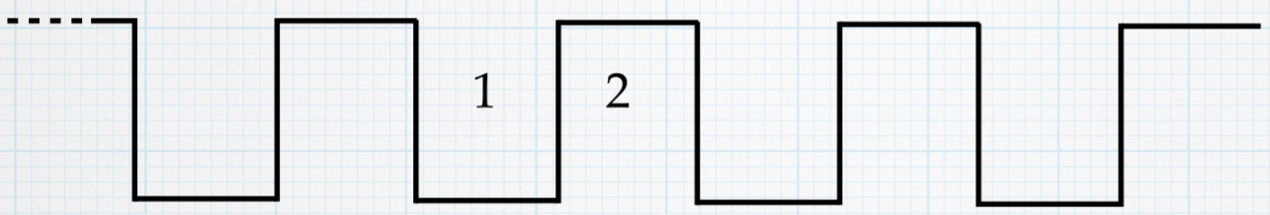
Homework
1. One-dimensional Kronig-Penney problem
Periodic potential
Using FFT, find the lowest three eigenvalues of the eigenstates that satisfy
a
U₀
L_{W}
L_{B}
U₀= 2 eV, L_{W} = 0.9 nm and L_{B} = 0.1 nm (a = 1 nm).

Slide 62
FFT

Slide 63
2. Detecting periodicity: Download the file called sunspots.txt, which contains the observed number of sunspots on the Sun for each month since January 1749.
Write a program to calculate the Fourier transform of the sunspot data and then make a graph of the magnitude squared |c_{k}|² of the Fourier coefficients as a function of k—also called the power spectrum of the sunspot signal. You should see that there is a noticeable peak in the power spectrum at a nonzero value of k. Find the approximate value of k to which the peak corresponds. What is the period of the sine wave with this value of k?

